Slide 1


Title
Date
Department
CONFIDENTIAL – Contains proprietary information.
Not intended for external distribution.

Slide 2

Title
Date
Department
CONFIDENTIAL – Contains proprietary information.
Not intended for external distribution.

Slide 3
Title
Date
Department
CONFIDENTIAL – Contains proprietary information.
Not intended for external distribution.

Slide 4
OUR MISSION
Saving the lives of sisters,
mothers, daughters, wives and friends
through innovative breast care.

Slide 5






VALUES
In pursuit of our mission and to best serve our patients, we stand by the following value statements:
We show initiative and take ownership
We value our teammates
We are committed to building relationships
We embrace challenges with confidence
We seek continuous improvement
CONFIDENTIAL – Contains proprietary information.
Not intended for external distribution.

Slide 6




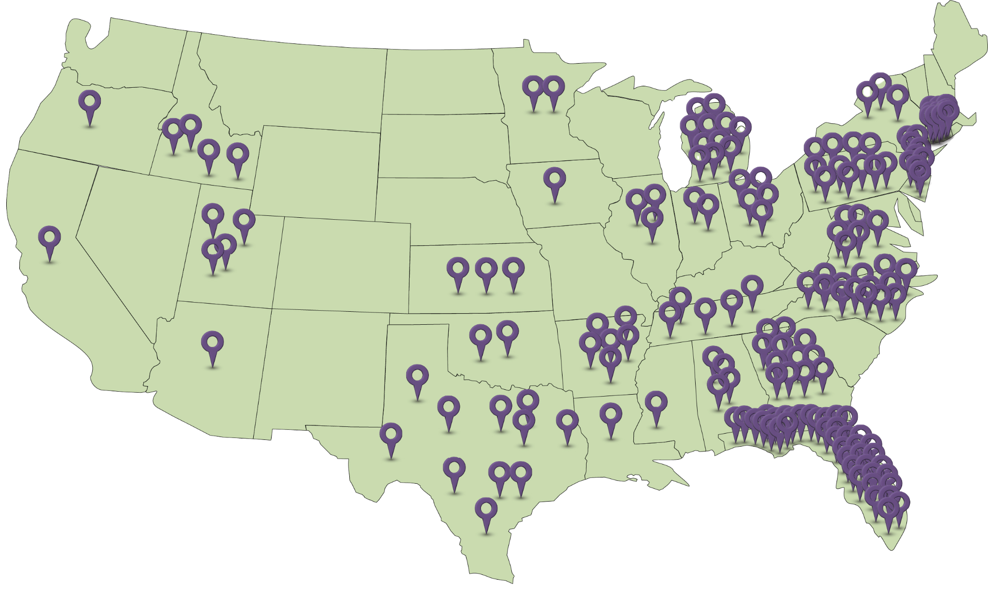


Company Overview
By the numbers
Our Services:
175+
centers
Who We Are
The leading provider of in-office breast health and imaging partner to physicians and their patients across the country
Who We Benefit
Unique model generates exceptional value to all constitutes: Providers, Patients and Payors
How We Do It
Partner with physicians to offer best-in-class diagnostic services inside offices
28
states
600+
employees
600K+
projected breast exams in 2026
98%
partner retention
3D Screening Mammography with integrated AI software
Additional service offerings:
Automated Whole-Breast Ultrasound (ABUS)
Diagnostic Mammography
Diagnostic Breast Ultrasound
DEXA
85%
of patients opt to add screening mammography to their annual wellness visit*
*in mature locations
Centers
Headquarters

Slide 7
Who We Are
Onsite Women’s Health Locations
28+
175+
600K+
98%
85%
By The Numbers
states
centers
Projected breast exams in 2026
Partner retention
Of patients opt to add screening mammography to their annual wellness visit*
In partnership with forward-thinking providers across the country, Onsite offers comprehensive in-office breast health and imaging services.
Centers
Headquarters
*in mature locations

Slide 8


Company Timeline
175+
110
87
74
2025
55
2022
38
2021
15
17
2020
2019
2018
2013
2008
OnSite Mammography founded
Transitions from 2D to 3D mammography
Begins offering Patient Risk Assessment
Opens 50th site; Begins offering Automated Whole-Breast Ultrasound
Builds Research and Development team
Opens 100th site; Rebrands as Onsite Women’s Health
Continual growth via new and existing sites
Partners with first Primary Care site

Slide 9
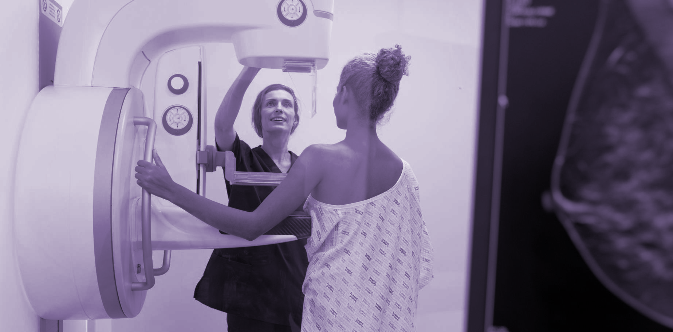
Elevate patient care with in-office breast health and imaging services

Slide 10


Onsite Women’s Health screening services increase the likelihood of identifying cancer in early stages.
Convenience drives breast cancer screening compliance, and compliance saves lives.

Slide 11

Why Partner with Onsite Women’s Health
Benefit from decades of experience delivering in-office breast imaging services nationwide
Instantly elevate your practice with no capital equipment investment
Improve patient satisfaction, loyalty and clinical outcomes
Drive screening compliance and out-perform breast cancer quality metrics
Unlock a new revenue stream – without adding operational complexity
CONFIDENTIAL – Contains proprietary information.
Not intended for external distribution.

Slide 12


Why Partner with Onsite Women’s Health
Benefit from decades of experience delivering in-office breast imaging services nationwide
Instantly elevate your practice with no capital equipment investment
Improve patient satisfaction, loyalty and clinical outcomes
Drive screening compliance and out-perform breast cancer quality metrics
Unlock a new revenue stream – without adding operational complexity
CONFIDENTIAL – Contains proprietary information.
Not intended for external distribution.

Slide 13


Turnkey Support
Breast-specialized radiologists
Dedicated implementation and operations support team
Highly-skilled mammography technologists
Patient coordination and follow-up communication
All equipment and mammography supplies and maintenance with zero upfront cost
Full MQSA compliance and ACR accreditation oversight, including inspection management
Seamless PACS and mammography information system platform for imaging reporting
24-hour average turnaround time for screening interpretations
Proven marketing and outreach programs to boost patient compliance
Onsite manages the complexity—so your practice doesn’t have to.
From staffing and training to equipment, compliance, billing support, marketing, technology and patient navigation, we handle the heavy lift behind the scenes.
You stay focused on delivering exceptional care while we power the operation.
CONFIDENTIAL – Contains proprietary information.
Not intended for external distribution.

Slide 14









The Onsite Model
Onsite Responsibilities
IMPLEMENTATION TEAM
EQUIPMENT
EXPERIENCED AND CERTIFIED IMAGING TECHNOLOGIST
BREAST-SPECIALIZED RADIOLOGISTS
FDA & ACR COMPLIANCE
MARKETING
PATIENT TRACKING & FOLLOW-UP
Practice Responsibilities
SPACE
APPOINTMENT SCHEDULING
BILLING/COLLECTING

Slide 15
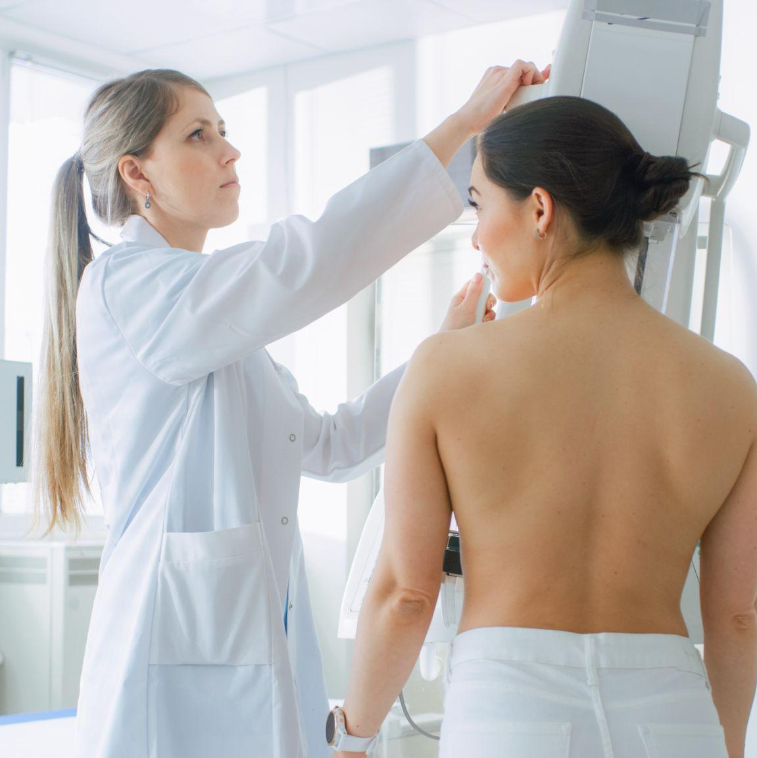
Services
3D Screening Mammography with integrated AI software
Additional service offerings:
Automated Whole-Breast Ultrasound (ABUS)
Diagnostic Mammography
Diagnostic Breast Ultrasound
DEXA
The convenience of our comprehensive service line encourages patients to stay current with their annual screenings, strengthening the overall quality of preventive care at your practice.

Slide 16
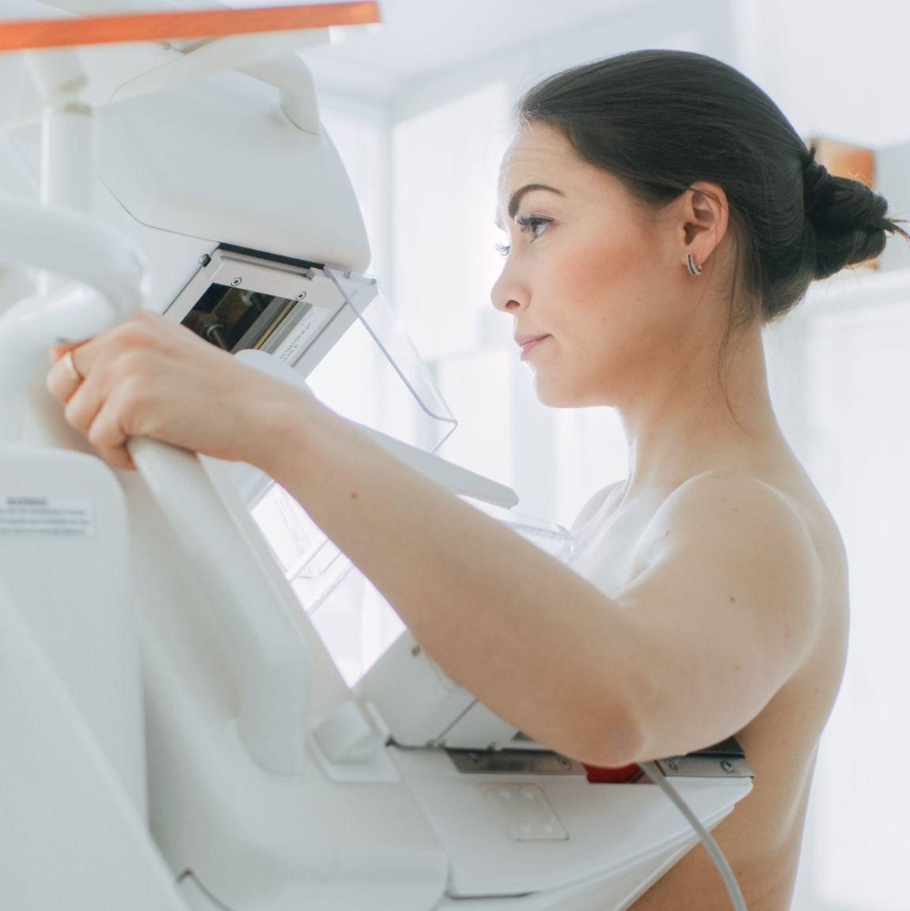
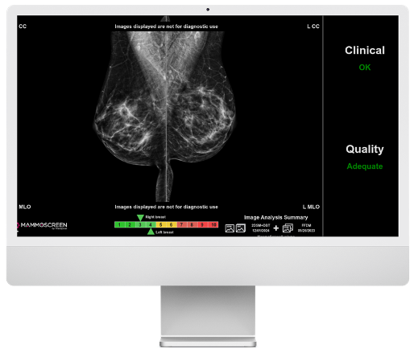
3D Screening Mammography with enhanced AI
3D Screening Mammography with enhanced AI
Onsite intentionally curates this suite of AI enhancements for mammography so we can:
Reduce false positives and callbacks
MammoScreen®
•Detects cancer earlier with AI
Volpara TruDensity®
•Measures breast density accurately
Volpara Analytics®
•Optimizes position and image quality
WhiteRabbit WRRisk®
Calculates lifetime cancer risk
Detect breast cancer earlier
Improve detection in tumors in women with dense breast tissue

Slide 17
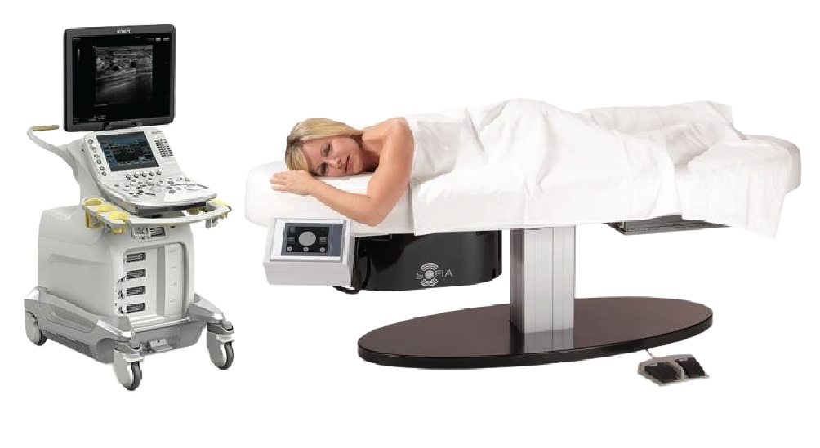
Automated Whole-Breast Ultrasound (ABUS)
Our density assessment software helps to identify those patients with dense breast tissue who need a breast ultrasound.
Supplemental ultrasound to offer a more focused view at areas of concern and is important for women with dense breast tissue.
Patients can receive a full complement of screening services without having to leave your office.
Automated whole-breast ultrasound provides a more consistent, comprehensive and quick way to screen for abnormalities than handheld breast ultrasound

Slide 18
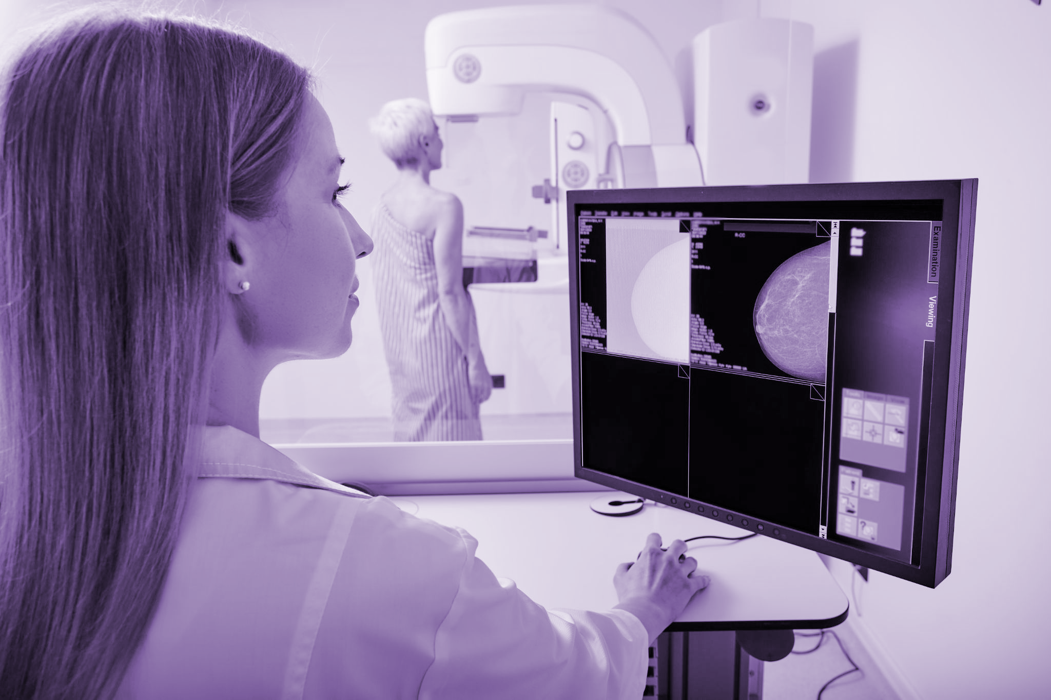
Diagnostic Mammography + Breast Ultrasound
Offering comprehensive evaluation of breast abnormalities under one roof, your practice can gain a competitive advantage including:
Exceptional quality through continuity of care: Patients receive their diagnostic imaging with the same trusted technologists and clinical partners who perform their annual screenings.
Greater access with faster appointment availability: Onsite’s integrated model allows practices to schedule diagnostic follow-ups sooner, helping patients get answers quickly and reducing delays in care.
Stronger patient retention that drives volume: When patients return to the same practice for both screening and diagnostic imaging, practices see increased continuity, higher satisfaction and improved downstream volume.

Slide 19
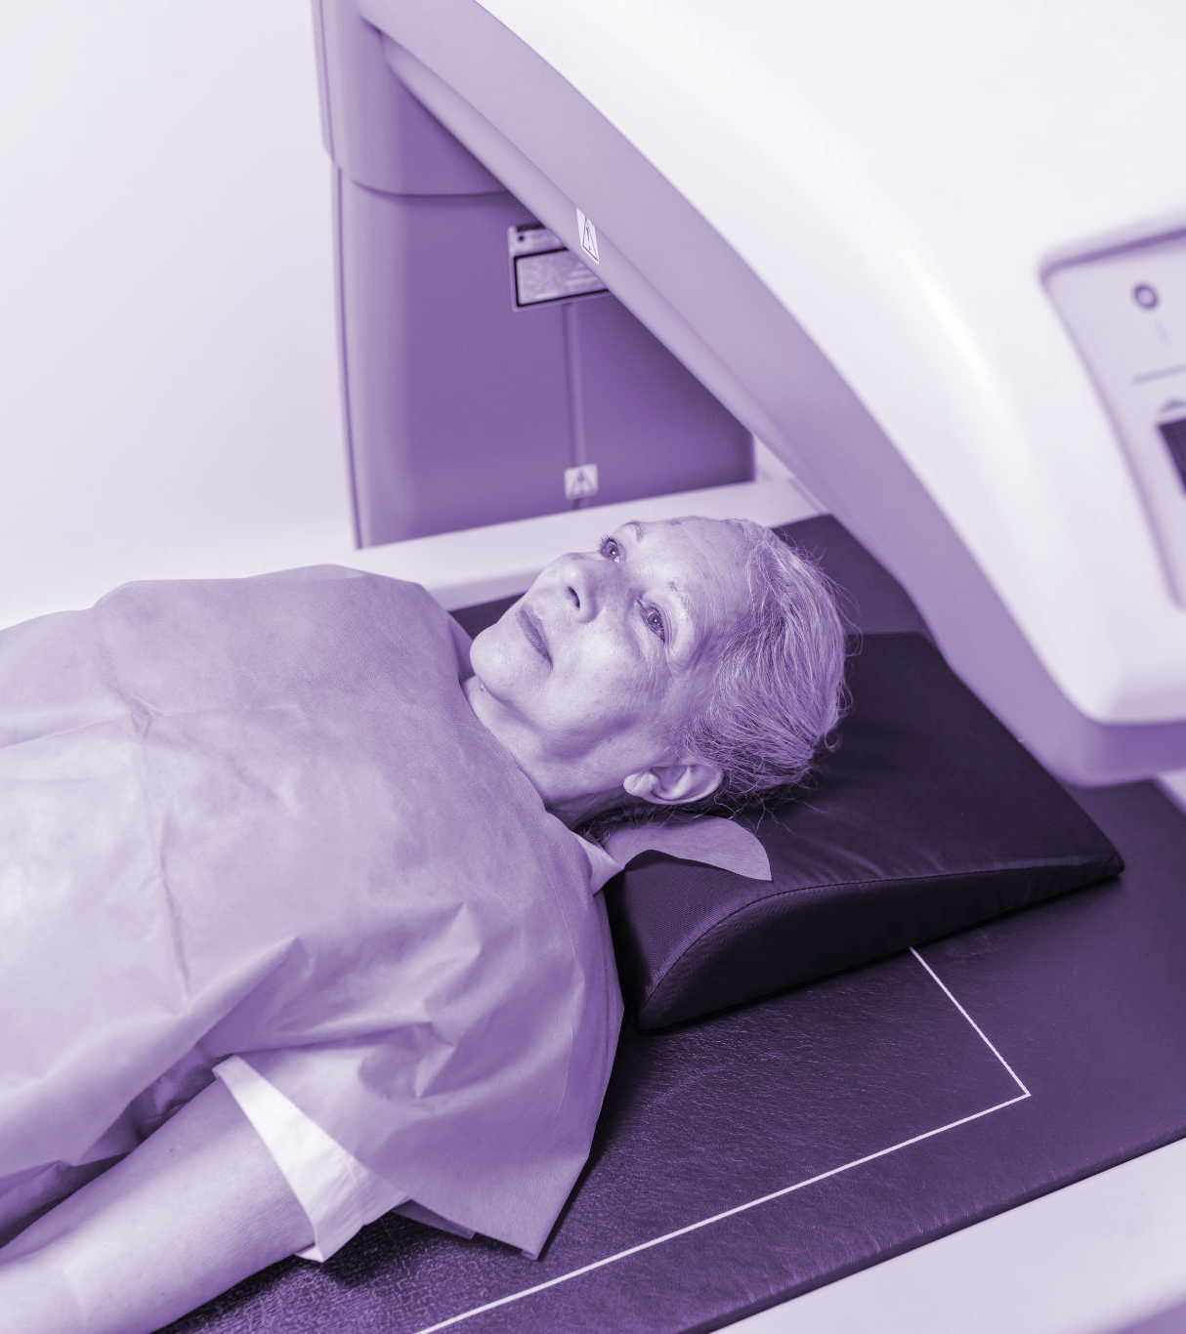
DEXA Bone Density Scan
Offering bone density alongside breast screening services not only aids in the early detection of osteoporosis and bone loss but can also:
Improve patient compliance with screenings
Provide patients convenient access to both screenings in one visit
Enhance patient outcomes by getting a more complete picture of the patient’s overall health
Attract a broader patient base

Slide 20
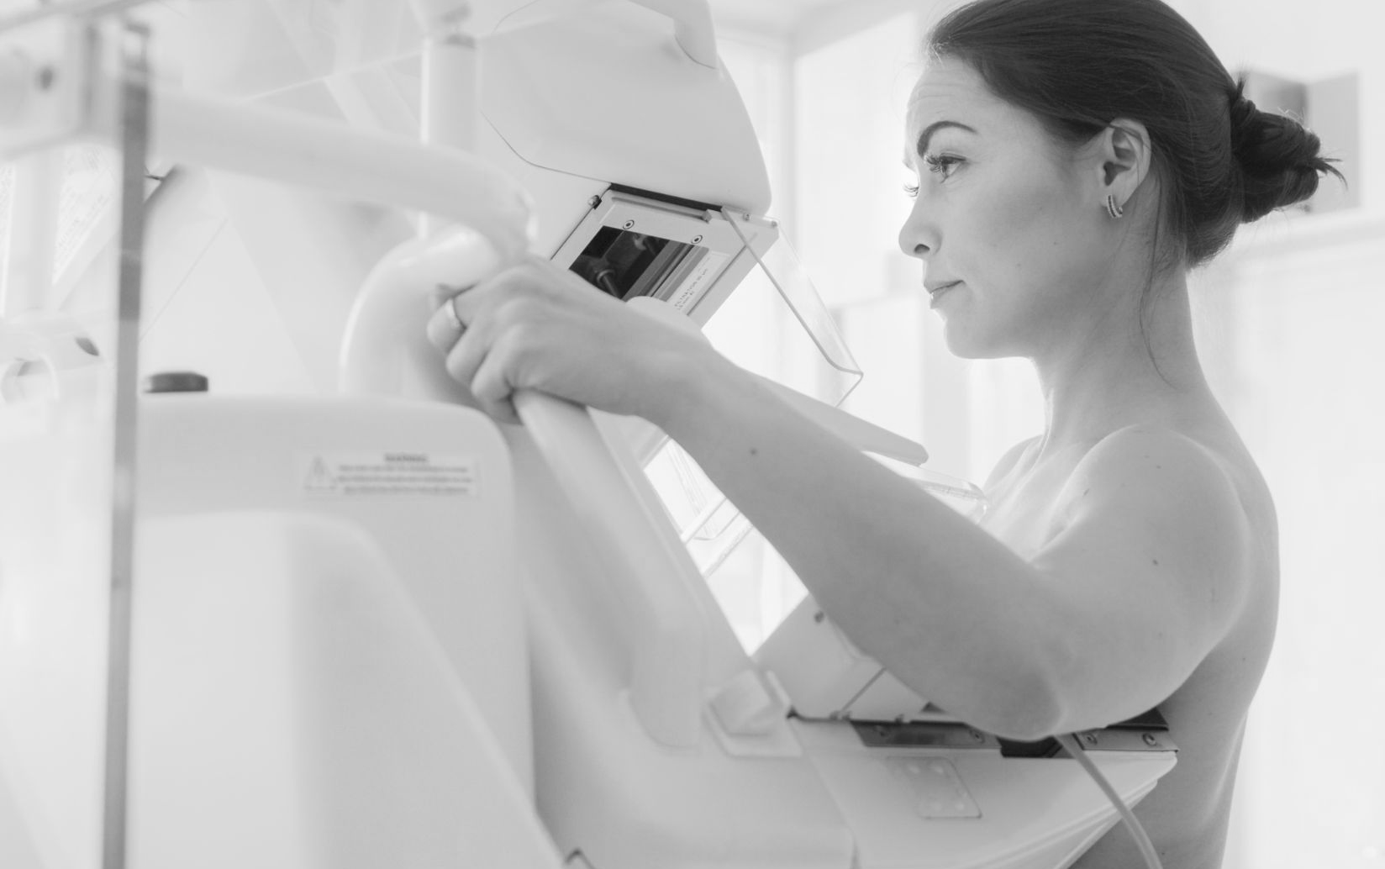

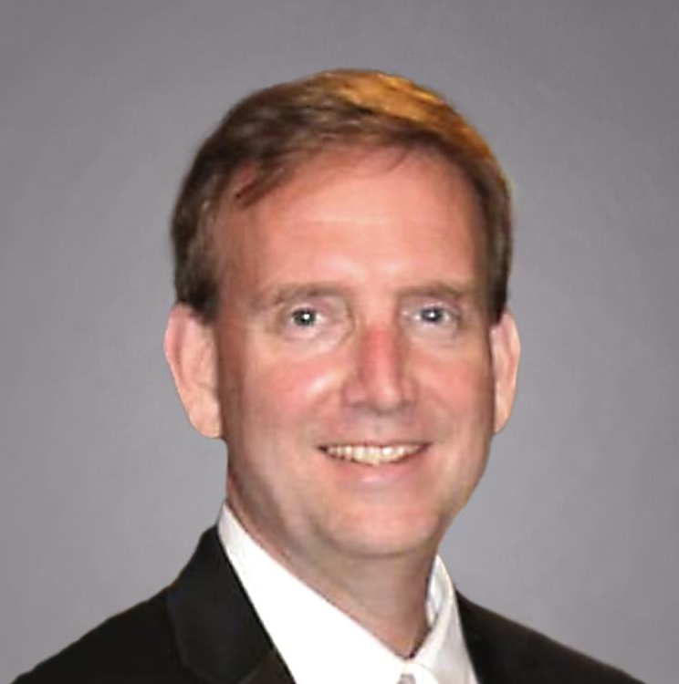
Breast Specialized Radiologists
We partner with more than 30 board-certified, U.S.-based breast imaging specialists - our key differentiator in every community we serve. These radiologists have devoted their careers to breast health, bringing a level of specialization that consistently leads to higher-quality results and improved outcomes for the women we serve. Behind every mammogram is a highly skilled expert dedicated to detecting early breast cancer and saving lives.
Radiology Leadership
Onsite-affiliated radiologists are:
Board-certified and U.S.-based
Fully credentialed and licensed
Experts in breast imaging interpretation
Dr. Susan Holley
Clinical Director, Onsite Women’s Health Breast Imaging Radiologist
Dr. Mike Spencer
CEO, Total Radiology Solutions Breast Imaging Radiologist

Slide 21
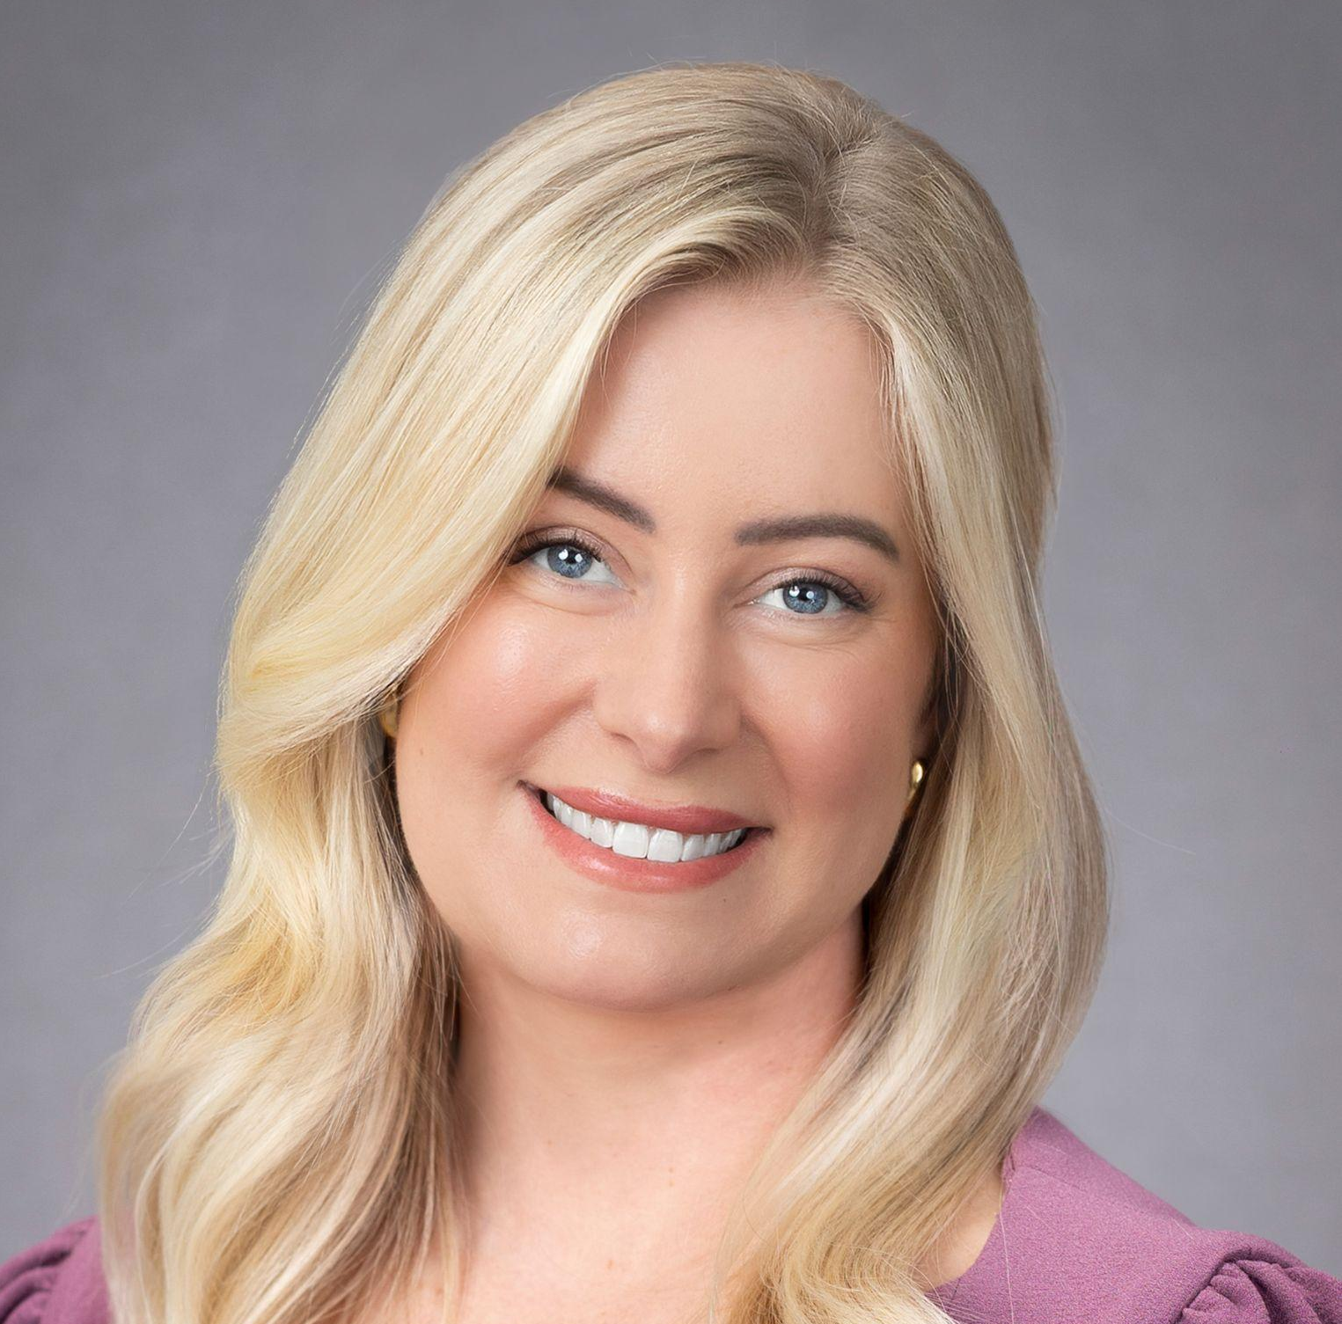

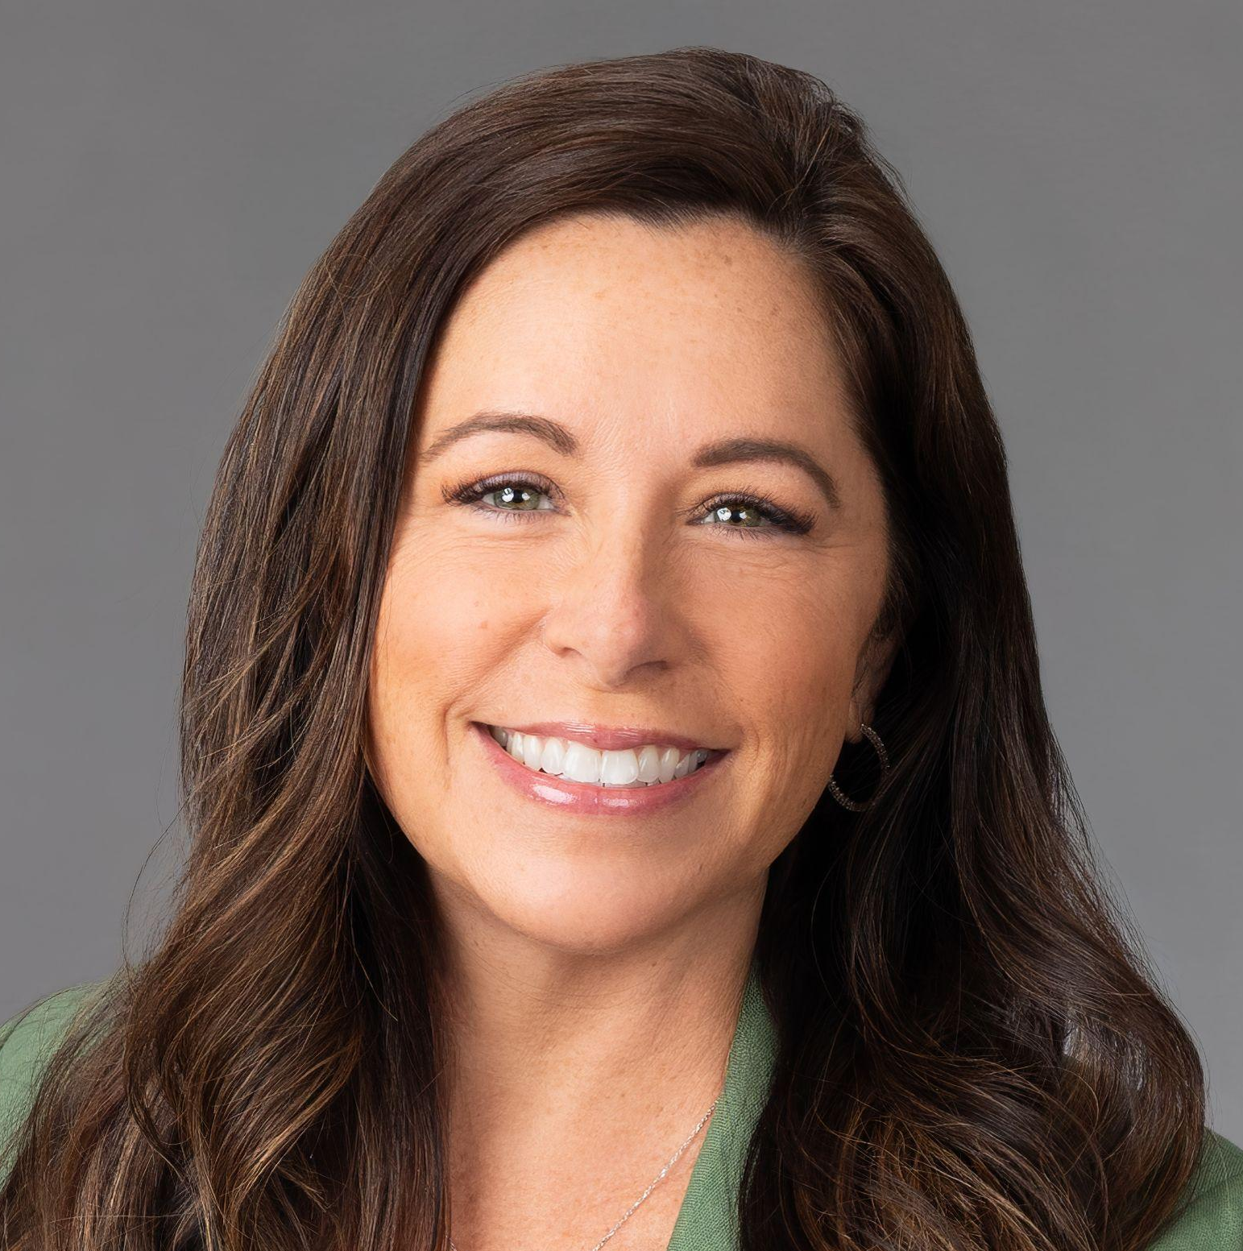
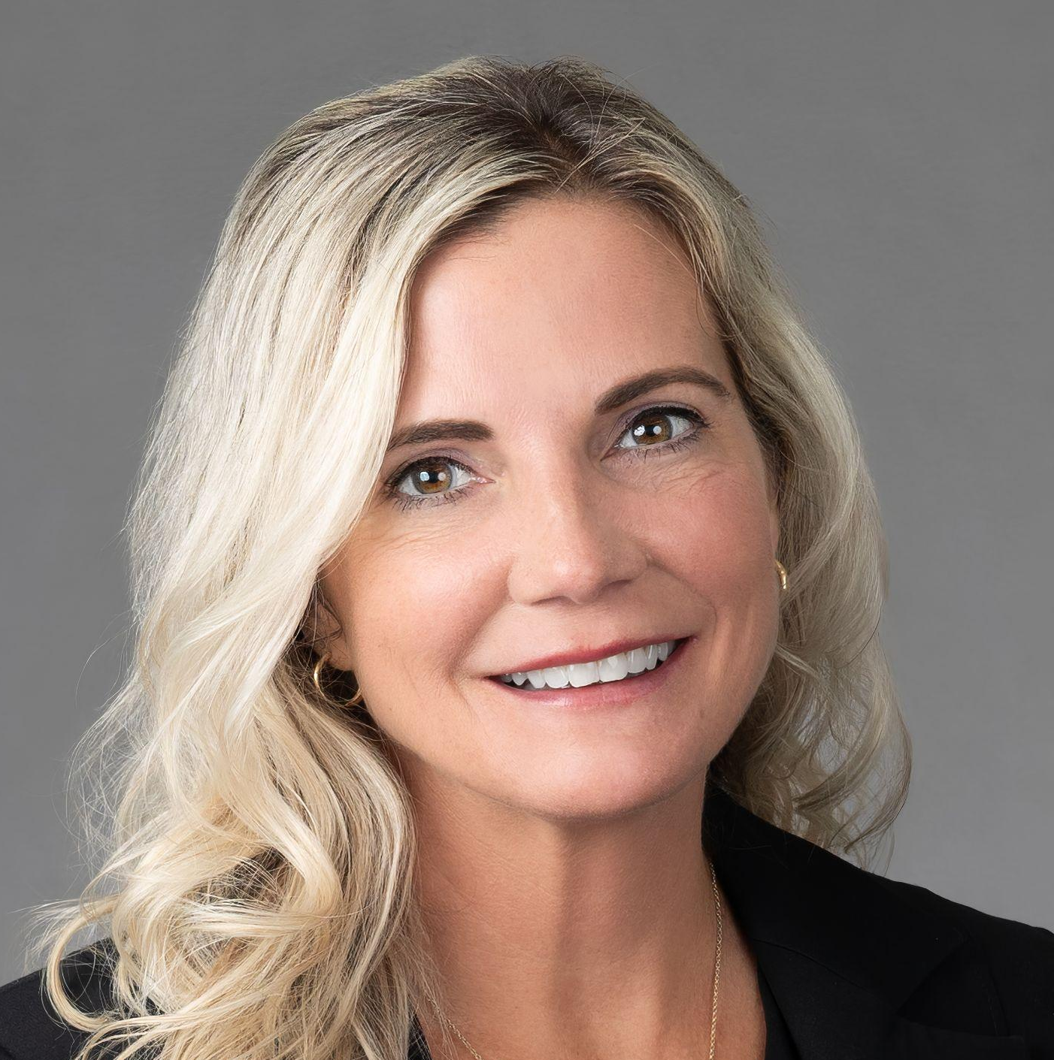


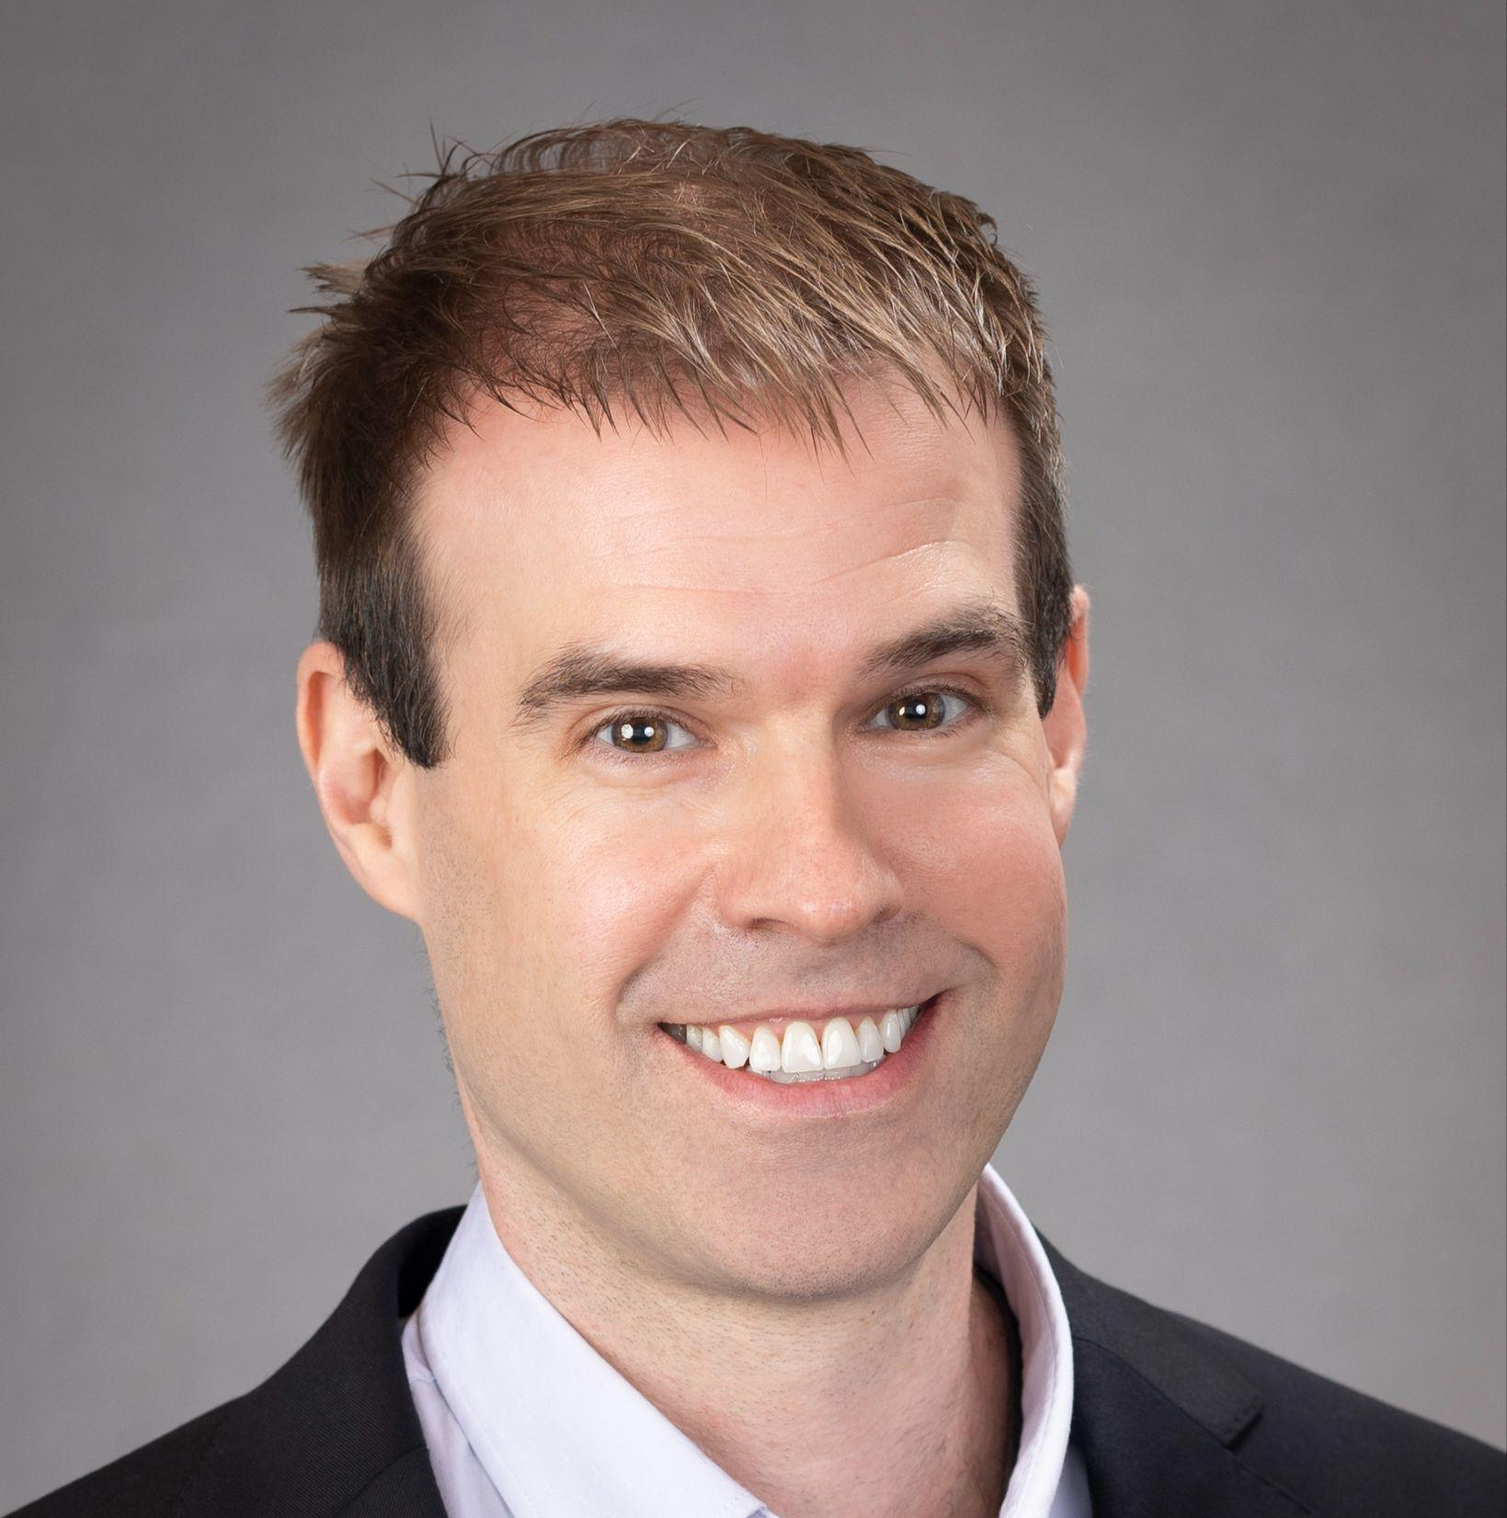

Executive Leadership Team
Jillian Wright
Chief Executive Officer
jwright@onsitewomenshealth.com
David Freedman
President/Chief Growth Officer
dfreedman@onsitewomenshealth.com
Kristy Rutherford
Chief Financial Officer
krutherford@onsitewomenshealth.com
Susan Holley, MD, PhD
Clinical Director
sholley@onsitewomenshealth.com
Suzanne Simmons
Chief Operating Officer
ssimmons@onsitewomenshealth.com
Justin Murphy
General Counsel, Chief Compliance and Privacy Officer
jmurphy@onsitewomenshealth.com
Robinette Eckers
Vice President, Human Resources
reckers@onsitewomenshealth.com
Nate Dolley
Senior Vice President, Information Technology
ndolley@onsitewomenshealth.com
Julie Plummer
Vice President, Marketing
jplummer@onsitewomenshealth.com

Slide 22


Slide 23

Leadership Team Template
Firstname Lastname
Title
Firstname Lastname
Title
Your bio text here et rem. Genimin vendita pa veriae, quiam fuga. Ut volupti squunt lacitatint molut restem sit, consequi re, voluptium nihil ipiet pa voluptat.
Ossinim aximpor accatem ut is dolorem poribus. Andiaerore, si consequata derrovid ma nobis et que que nobis natibere, commod et, sequasit, conseniet.
Your bio text here et rem. Genimin vendita pa veriae, quiam fuga. Ut volupti squunt lacitatint molut restem sit, consequi re, voluptium nihil ipiet pa voluptat.
Ossinim aximpor accatem ut is dolorem poribus. Andiaerore, si consequata derrovid ma nobis et que que nobis natibere, commod et, sequasit, conseniet.

Slide 24
Leadership Team Template
Firstname Lastname
Title
Firstname Lastname
Title
Your bio text here et rem. Genimin vendita pa veriae, quiam fuga. Ut volupti squunt lacitatint molut restem sit, consequi re, voluptium nihil ipiet pa voluptat.
Ossinim aximpor accatem ut is dolorem poribus. Andiaerore, si consequata derrovid ma nobis et que que nobis natibere, commod et, sequasit, conseniet.
Your bio text here et rem. Genimin vendita pa veriae, quiam fuga. Ut volupti squunt lacitatint molut restem sit, consequi re, voluptium nihil ipiet pa voluptat.
Ossinim aximpor accatem ut is dolorem poribus. Andiaerore, si consequata derrovid ma nobis et que que nobis natibere, commod et, sequasit, conseniet.

Slide 25





Our Partnerships
We believe collaboration drives innovation and that we are better together.

Slide 26
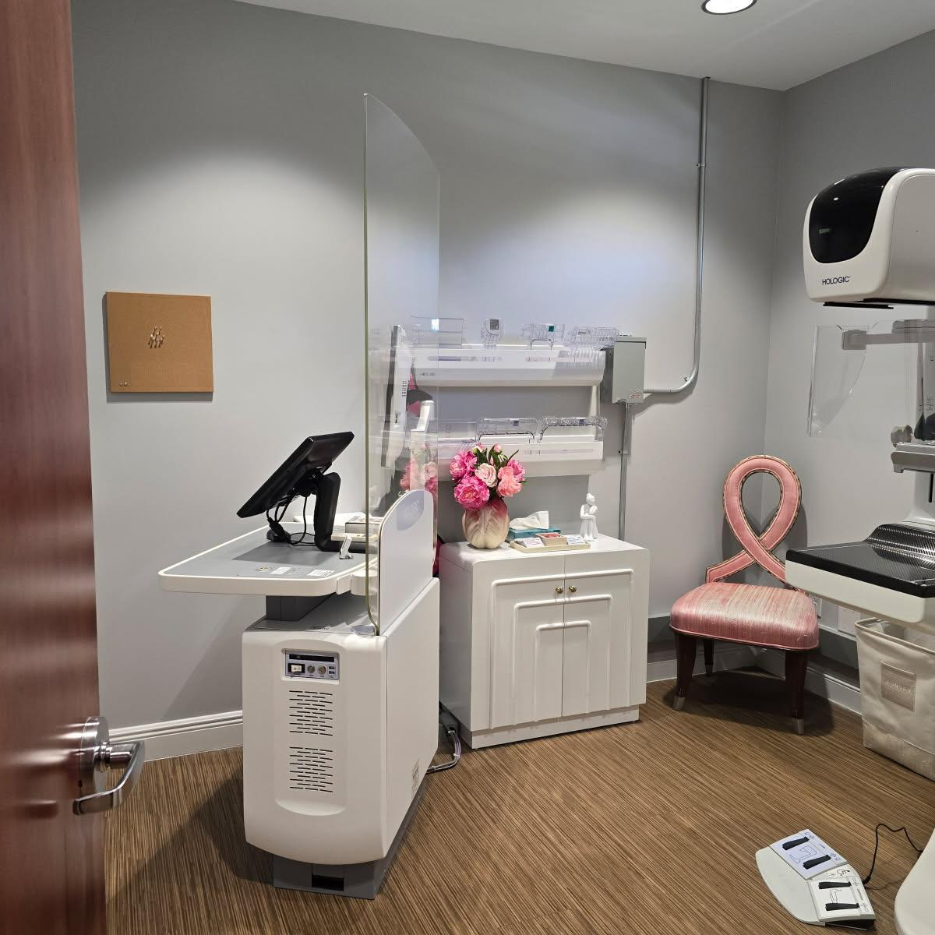
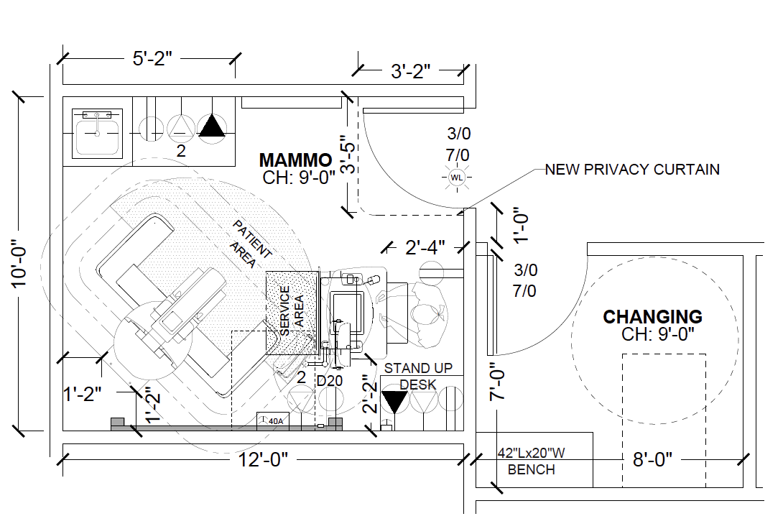
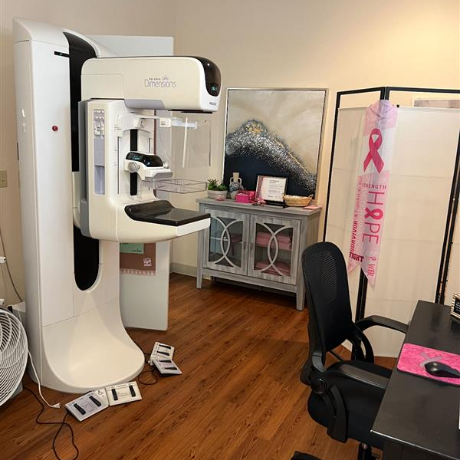
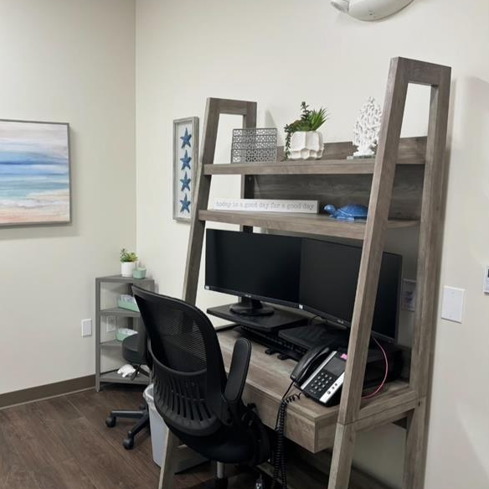
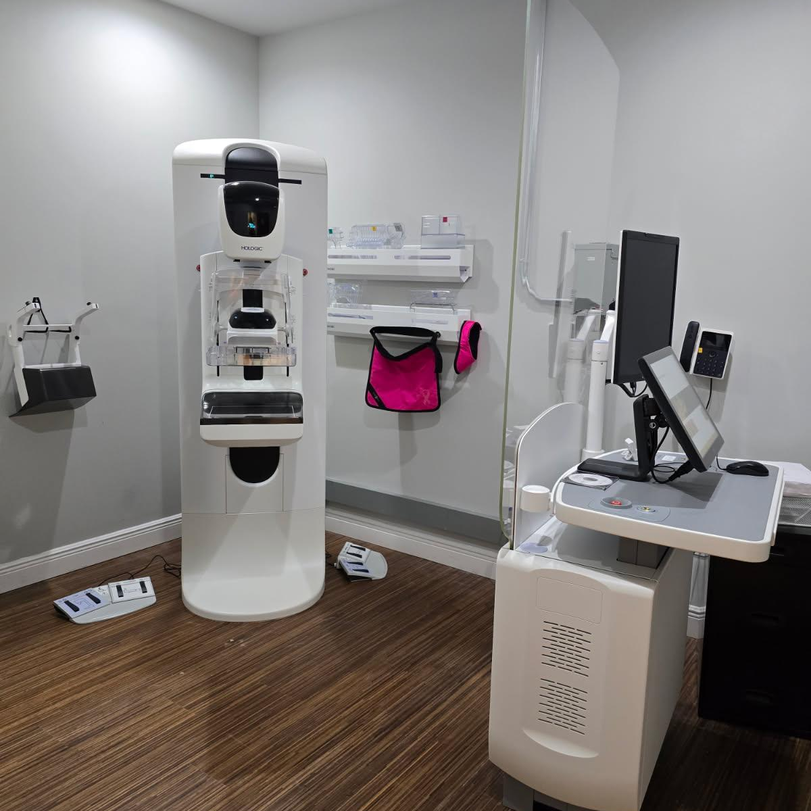
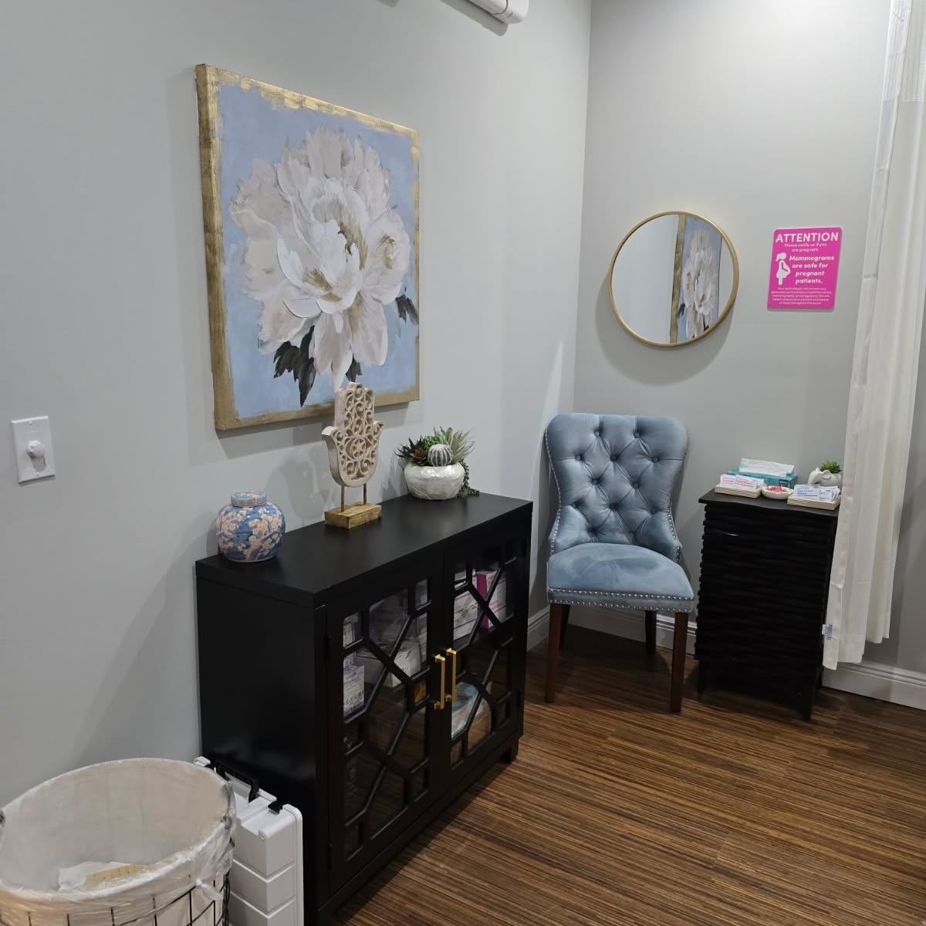
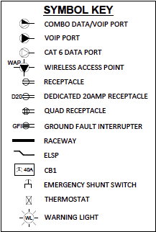
Screening Mammography Suite
Onsite Women’s Health
Provides drawings
Works with you and is flexible in making most spaces work
Supports you throughout the construction process
The Suite
Physician’s Practice
Provides a mammography-ready room that is at least 10’x12’

Slide 27
Onsite & Practice Name, Location
Your logo
WHY ONSITE?
Es exped maioreped estis aut fugiam, sim ereicidi ad qui sim occuptatur illa minimagnatum eossit
Porecab illa eos minimagnatum eos eossit aut ad qui
Es exped maioreped estis aut fugiam, sim ereicidi ad qui sim
Porecab illa eos minimagnatum eos eossit aut ad qui
Es exped maioreped estis aut fugiam
SUBHEADLINE GOES HERE
Es exped maioreped estis aut fugiam, sim ereicidi ad qui sim occuptatur
Porecab illa eos minimagnatum eos eossit aut ad qui
Es exped maioreped estis aut fugiam
Porecab illa eos minimagnatum eos eossit aut ad qui
Es exped maioreped estis aut fugiam
COMMUNITY NEED
Es exped maioreped estis aut fugiam, sim ereicidi ad qui sim
Porecab illa eos minimagnatum eos eossit aut ad qui

Slide 28
Onsite & Practice Name, Location
Your logo
WHY ONSITE?
Es exped maioreped estis aut fugiam, sim ereicidi ad qui sim occuptatur illa
Porecab illa eos minimagnatum eos eossit aut ad qui
Es exped maioreped estis aut fugiam, sim ereicidi ad qui sim occuptatur illa
Porecab illa eos minimagnatum eos eossit aut ad qui
Es exped maioreped estis aut fugiam
COMMUNITY NEED
Es exped maioreped estis aut fugiam, sim ereicidi ad qui sim occuptatur illa
Porecab illa eos minimagnatum eos eossit aut ad qui
Es exped maioreped estis aut fugiam, sim ereicidi ad qui sim occuptatur illa
Porecab illa eos minimagnatum eos eossit aut ad qui
Es exped maioreped estis aut fugiam
SUBHEADLINE GOES HERE
Es exped maioreped estis aut fugiam, sim ereicidi ad qui sim occuptatur illa
Porecab illa eos minimagnatum eos eossit aut ad qui
Es exped maioreped estis aut fugiam
Es exped maioreped estis aut fugiam, sim ereicidi ad qui sim occuptatur illa
Porecab illa eos minimagnatum eos eossit aut ad qui
Es exped maioreped estis aut fugiam

Slide 29
Onsite & Practice Name, Location
Your logo
Company Name
Community need
Why Onsite?
Subheadline
Es exped maioreped estis aut fugiam, sim ereicidi ad qui sim occuptatur illa
Porecab illa eos minimagnatum eos eossit aut ad qui
Es exped maioreped estis aut fugiam
Es exped maioreped estis aut fugiam, sim ereicidi ad qui sim occuptatur illa
Porecab illa eos minimagnatum eos eossit aut ad qui
Es exped maioreped estis aut fugiam
Es exped maioreped estis aut fugiam, sim ereicidi ad qui sim occuptatur illa
Porecab illa eos minimagnatum eos eossit aut ad qui
Es exped maioreped estis aut fugiam

Slide 30
Onsite & Practice Name, Location
Your logo
Community Need
Es exped maioreped estis aut fugiam, sim ereicidi ad qui sim occuptatur illa
Porecab illa eos minimagnatum eos eossit aut ad qui
Es exped maioreped estis aut fugiam
Why Onsite?
Es exped maioreped estis aut fugiam, sim ereicidi ad qui sim occuptatur illa
Porecab illa eos minimagnatum eos eossit aut ad qui
Es exped maioreped estis aut fugiam
Customer Relationships
Es exped maioreped estis aut fugiam, sim ereicidi ad qui sim occuptatur illa
Porecab illa eos minimagnatum eos eossit aut ad qui
Es exped maioreped estis aut fugiam
Subheadline
Es exped maioreped estis aut fugiam, sim ereicidi ad qui sim occuptatur illa
Porecab illa eos minimagnatum eos eossit aut ad qui
Es exped maioreped estis aut fugiam

Slide 31
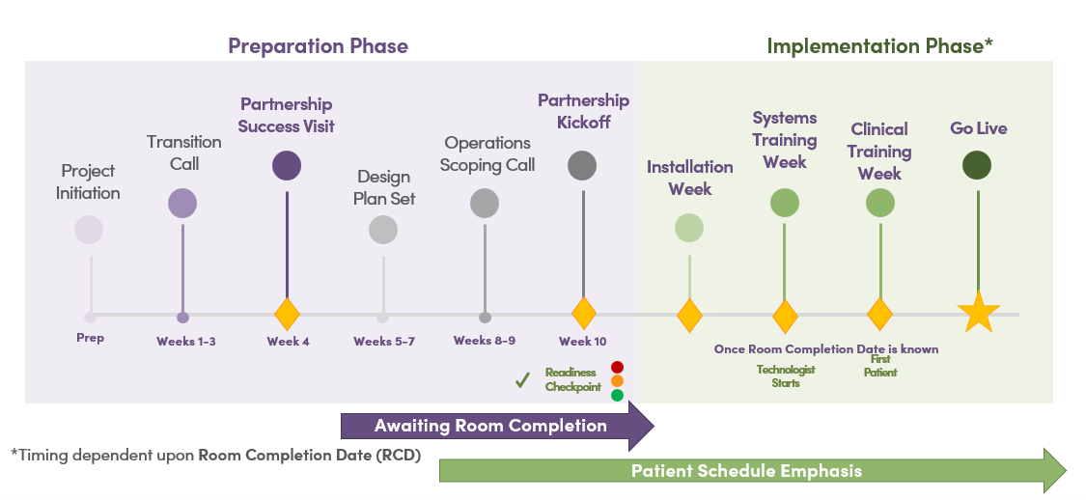
Next Steps
Total Implementation Timeline
Provide Onsite with requested data
Onsite prepares a proforma
Onsite prepares a Partner Service Proposal
Review and execute partner contract
Work with implementation team for transition

Slide 32
APPENDIX

Slide 33
Diagnostic Mammo + Diagnostic Ultrasound
APPENDIX
Offering diagnostic mammography and breast ultrasound is beneficial when there is limited local diagnostic appointment availability and/or patients are not returning for screening after being referred elsewhere for diagnostics. Diagnostic (DX) services are subject to different compliance requirements than screening mammography and viability is evaluated site-by-site, as it must fall into a specific operational model.
EVALUATING YOUR OFFICE FOR DX SERVICES:
Can the practice provide an ultrasound machine for DX US appointments?
Yes – This is the preferred scenario and is the most cost-effective outcome.
No – OWH can purchase a machine for the practice (invoiced as a monthly fee).
Can the practice provide a breast-trained sonographer available for breast US appointments?
Yes – This is the preferred scenario and is the most cost-effective outcome.
No – OWH can contract a sonographer for one day a week (daily fee of $600).
KEY STEPS FOR IMPLEMENTING DX SERVICES:
The interpreting radiologist must bill your practice directly for the professional component (PC) of government payor exams. Unlike screening mammography, this component is not included in OWH’s fee.
OWH will help coordinate a direct agreement between your practice and the radiologists for billing the PC.
Your practice will need to split-bill diagnostic exams (technical component + professional component).
The radiologists should be credentialed with the practice’s payors.
DX reports are delivered to your office within 24 hours of the exam being sent to the radiologist for interpretation.
The practice communicates B4/B5 results to patients and refers them to a downstream care facility for next steps.

Slide 34
Automated Whole-Breast Ultrasound (ABUS)
APPENDIX
Automated Whole-Breast Ultrasound (ABUS) is a supplemental screening tool designed to work in conjunction with a screening mammogram to detect potential instances of breast cancer in patients with dense breast tissue. Adequate screening mammography is required to support an ABUS program.
EVALUATING YOUR OFFICE FOR ABUS:
Are there sufficient ABUS-eligible patients (dense breast patients) currently receiving screening mammograms in your office? OWH recommends a minimum annual screening volume of 2,500, but staffing and reimbursements also influence this number.
Are you in a state with screening breast ultrasound-friendly policies and a community awareness of the benefit of ABUS?
Do you refer out a high number of patients for breast ultrasound screening, and is this impacting your screening capture rate?
KEY STEPS FOR IMPLEMENTING ABUS:
A separate room must be available for the ABUS machine (minimum 8’x8’). If space is unavailable, we can consider handheld whole-breast ultrasound as an alternative.
If the practice proceeds with ABUS exams, OWH will purchase the machine. If the practice proceeds with handheld US, the practice is responsible for purchasing the probes for its ultrasound machine.
If current staff do not have the capacity to conduct the projected ABUS exam, staffing augmentation and analysis may be required, and will potentially impact pricing.
Density is determined at the time of the mammogram (through a real-time software analysis program), and patients with dense tissue (C or D) can receive same-day ABUS exams.
Our teams will work together to educate patients on ABUS and schedule patients.

Slide 35
Downstream Health System Impact
APPENDIX
In-office screening mammography with Onsite Women’s Health (OWH) can be beneficial for hospitals and health systems. Market and internal data has proven that a health system’s relationship with a practice utilizing OWH’s in-office mammography solution has the opportunity to:
Address unmet demand, which limits potential screening mammography cannibalization / share impact
Improve share of downstream procedures, such as further diagnostic imaging, breast biopsy, and surgery
Penetrate new markets and realign downstream without requiring capital or operational investment
Promote tighter alignment with practice patients for greater share of downstream activity and revenue
Reduce patient wait times and anxiety by aligning scarce hospital radiology bandwidth with more acute diagnostic and follow up imaging care

