Slide 1
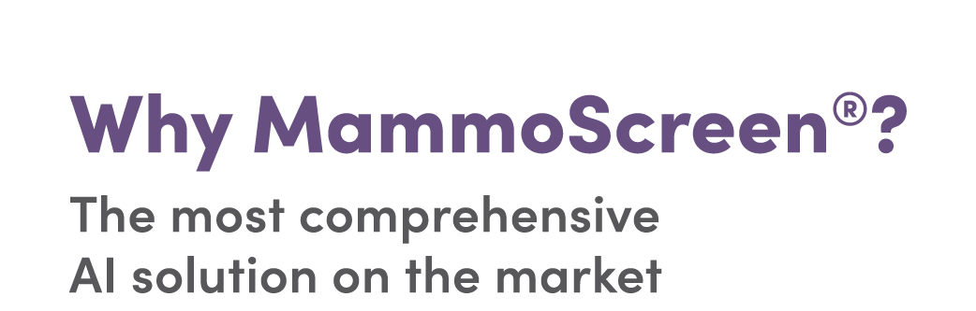
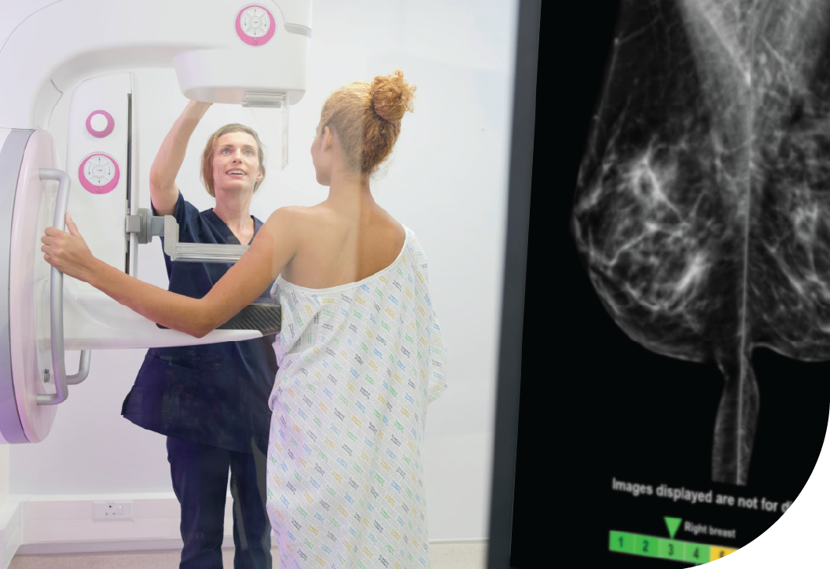
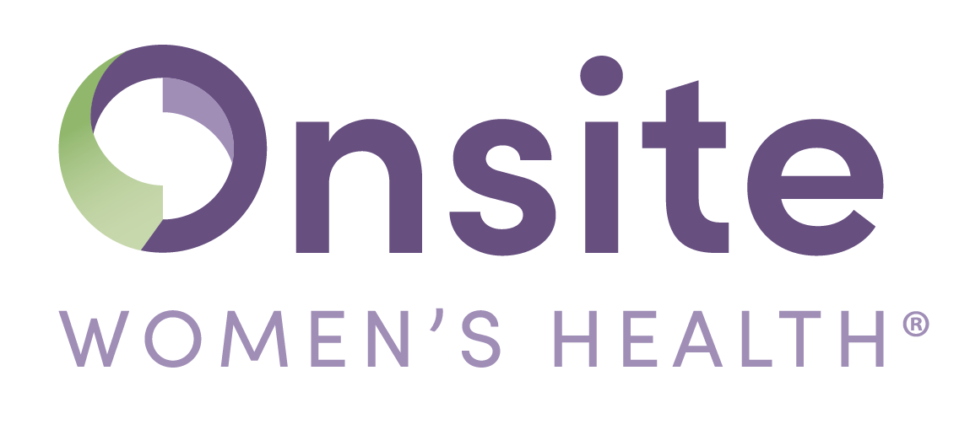
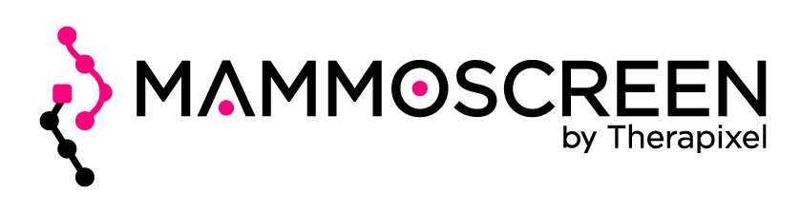
At Onsite Women’s Health, every mammogram includes MammoScreen® AI software, empowering Onsite radiologists with AI-driven insights to support earlier and more accurate breast cancer detection. This advanced technology acts as a second set of expert eyes, helping to identify cancers sooner and reduce false positives—so your patients can have greater peace of mind.
INCORPORATES PRIOR IMAGES
MammoScreen® is the first AI technology to incorporate the patient's prior images into the algorithm
READS BOTH 2D AND 3D IMAGES
Other AI models can read 2D or 3D images, but only MammoScreen® can read both, creating the most comprehensive AI assistant on the market
HIGHLY EFFECTIVE SCORING SYSTEM
Calibrated scoring from 1-10 that maps from the lesion, to the breast, to the case; best-in-class marking display
LEADS THE MARKET
MammoScreen® won the 2017 Mammography DREAM Challenge, outperforming over 1,000 global participants
In Q4 2024, Hologic announced its selection to commercialize MammoScreen® as the backbone of Hologic’s Genius AI Detection PRO Assistant – further solidifying Therapixel’s recognized leadership in the category
In March 2025, MammoScreen® was recognized with the NextGen Tech Award from Radiology Business Management Association

Slide 2
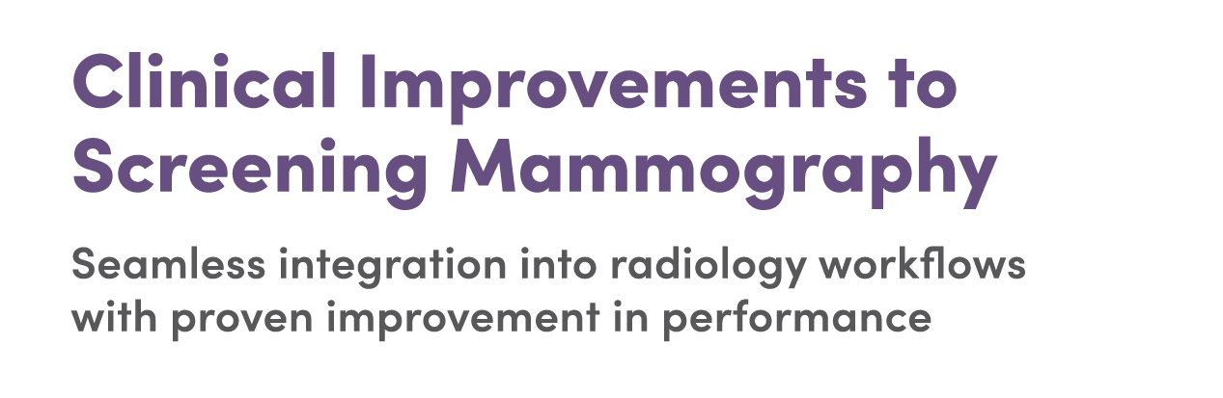
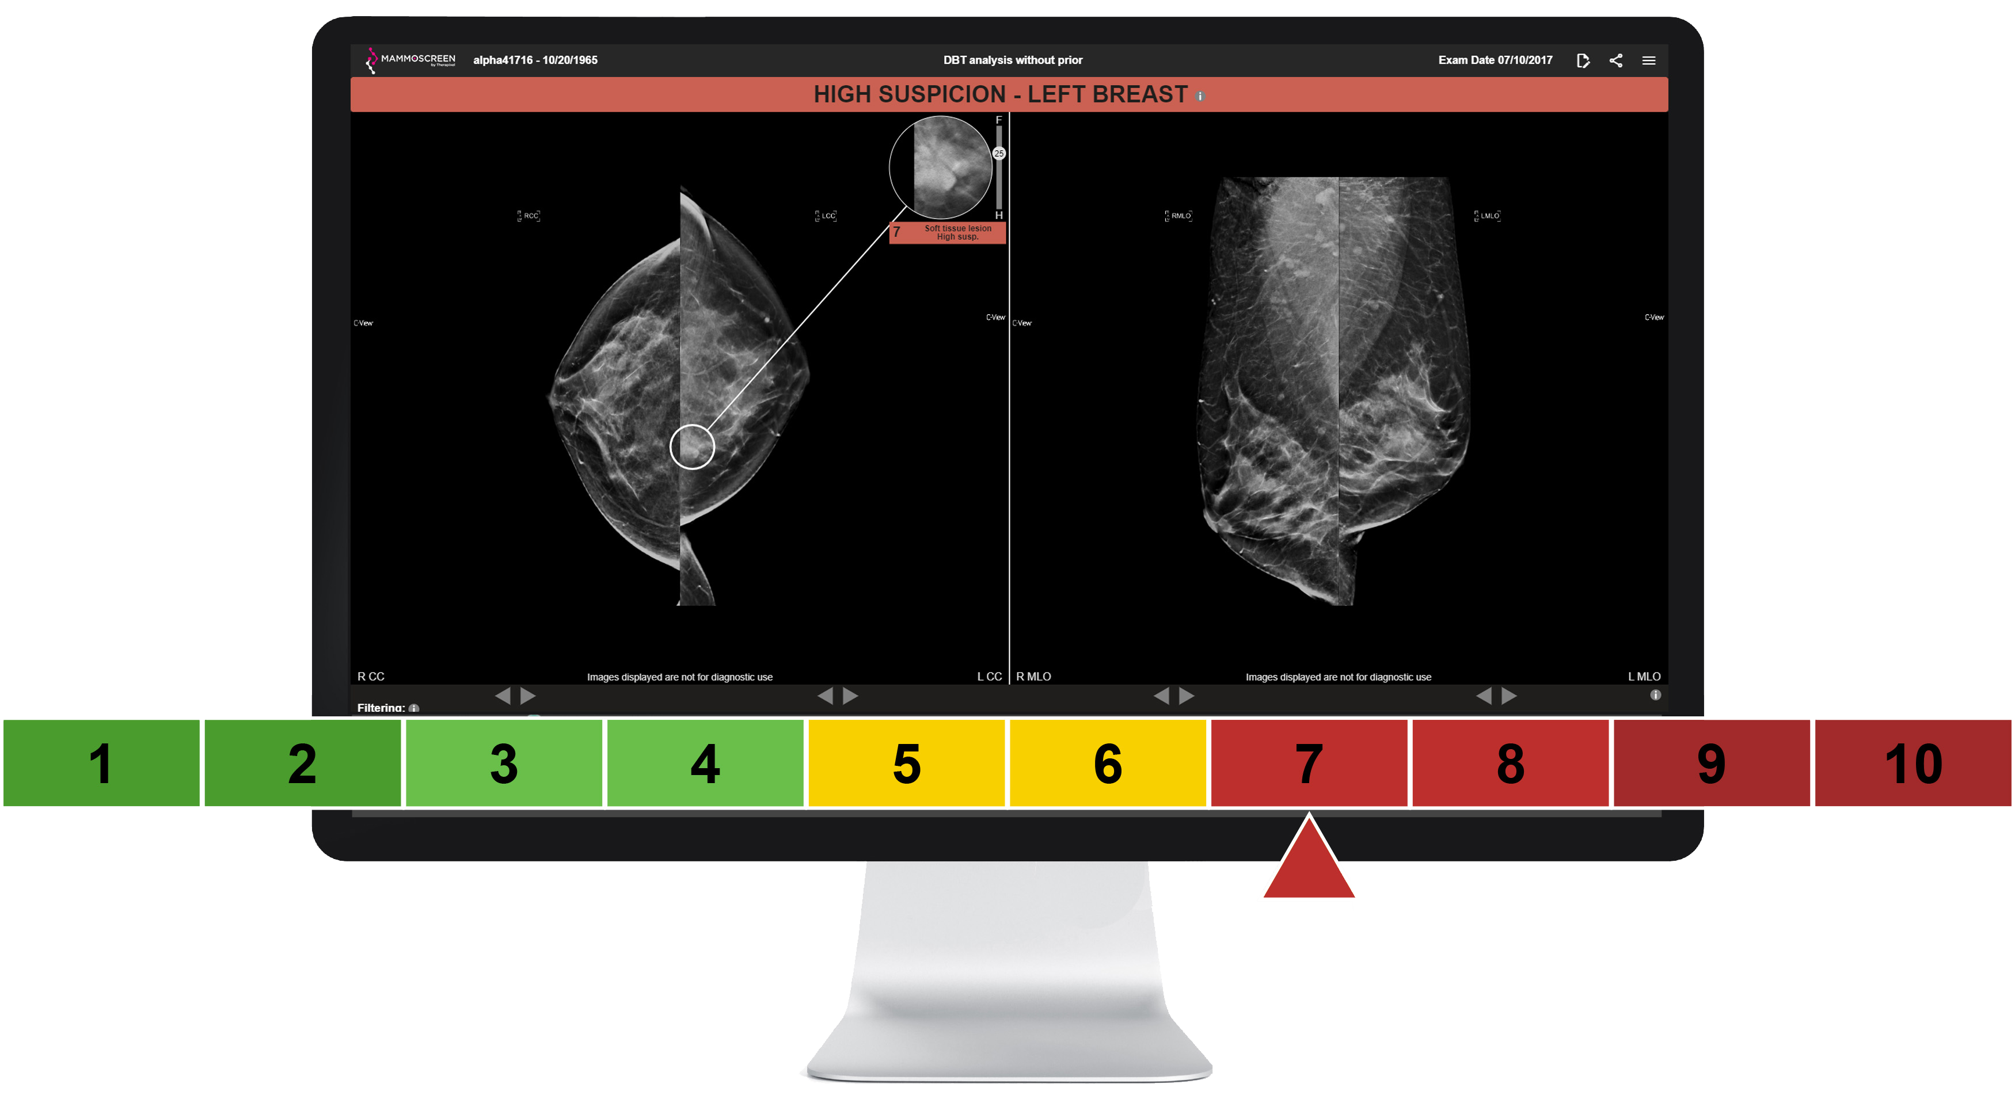
WITH THE EXPERTISE OF THE RADIOLOGIST AND MAMMOSCREEN®, WE CAN:
Find MORE breast cancers
Find breast cancers EARLIER
Find breast cancers more EFFICIENTLY
12%
42%
39%
11%
Increase in overall cancer detection rate**
Cancers detected
1 year earlier*
Cancers detected
2 years earlier**
Decrease in patient recall rate as a whole**
Recall rates will vary by Radiologist
*S.Pacilè, et al., (2022, November). A Novel Approach for the Evaluation of Artificial Intelligence on Consecutive Screening Mammograms. [conference presentation]. RSNA 2022
** Data on file from the most recent MRMC study, conducted for the latest 510(k) clearance [K240301]

