Slide 1


Breast Cancer Awareness Month
2026

Slide 2





OWH Breast Cancer Awareness 2026
Onsite Leadership Presence
Jillian Wright
David Freedman
Onsite Women’s Health
Chief Executive Officer
2026 Susan G. Komen
‘More Than Pink Walk’ Executive Leadership Chair (Nashville)
Onsite Women’s Health
President and Chief Growth Officer
2026 American Cancer Society
‘Men Wear Pink’ Ambassador

Slide 3

OWH Breast Cancer Awareness 2026
T-Shirts

Slide 4


OWH Breast Cancer Awareness 2026
“I’m Kicking Breast Cancer for” Patient Cards: Patients will fill out a card describing their personal reason for getting screened (ex. A breast cancer survivor, a loved one battling breast cancer, cheering for a cure, etc.

Slide 5
OWH Breast Cancer Awareness 2026
Donation Certificate

Slide 6
OWH Breast Cancer Awareness 2026
Posters and Flyers

Slide 7
OWH Breast Cancer Awareness 2026
Breast Cancer Selfie Frame

Slide 8
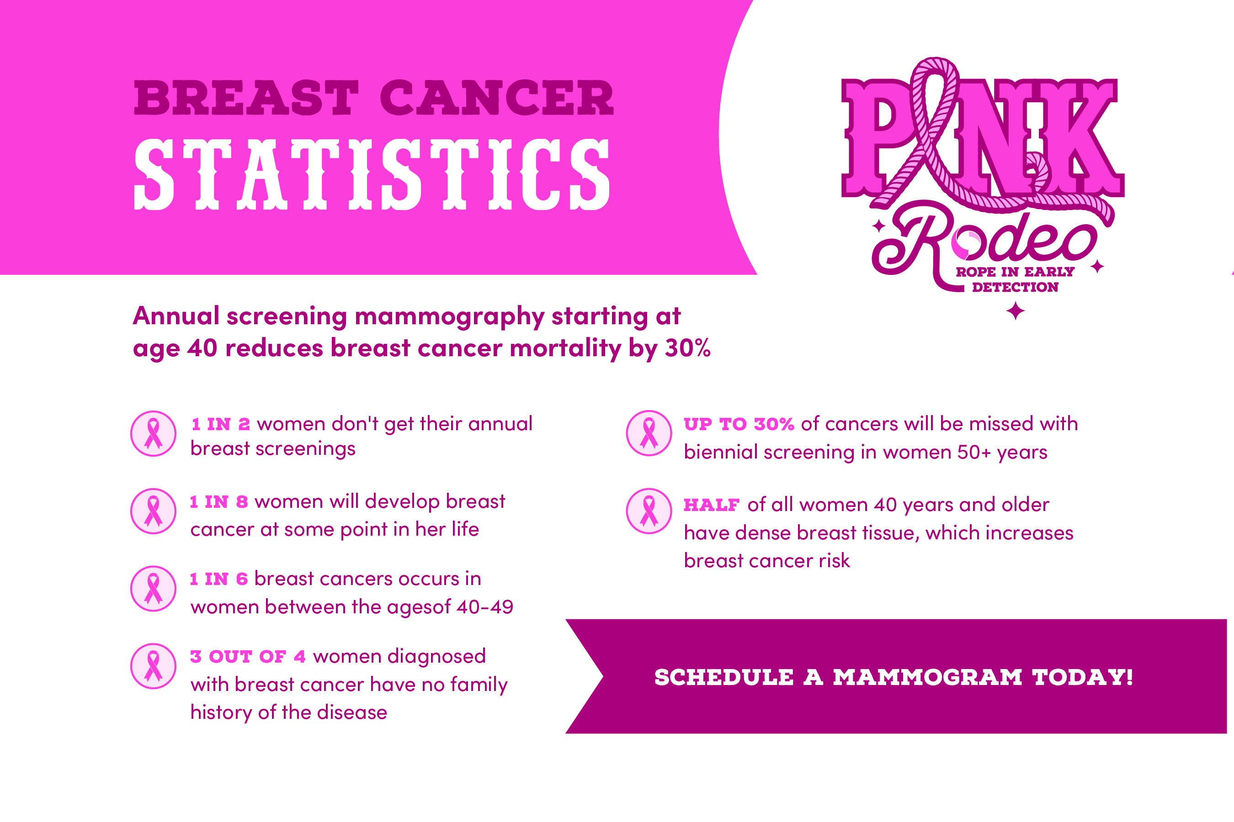
OWH Breast Cancer Awareness 2026
Breast Cancer Statistics Card

Slide 9
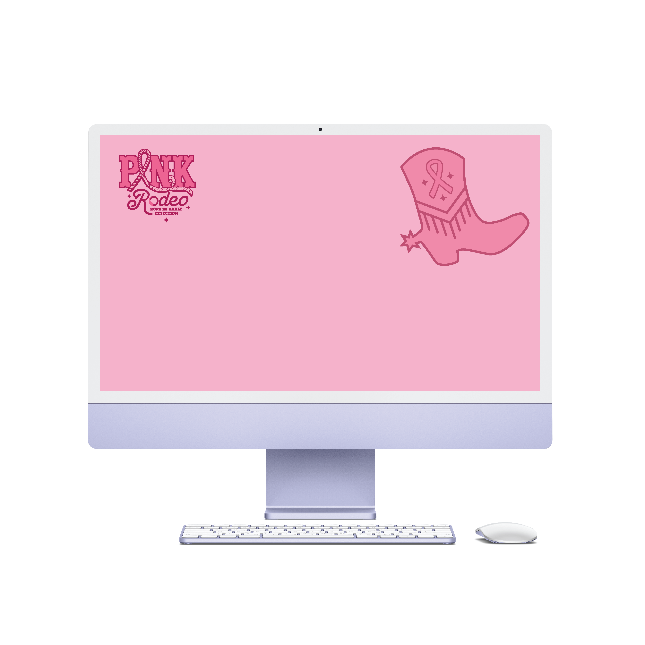

OWH Breast Cancer Awareness 2026
Teams Background

Slide 10



OWH Breast Cancer Awareness 2026
Social Media

Slide 11
October is Breast Cancer Awareness Month
Thank you for helping us ‘Rope In’ early detection!

